Slide 1
Conversation Class Australia
New Year’s Resolution
Christopher bAUMAN

Slide 2
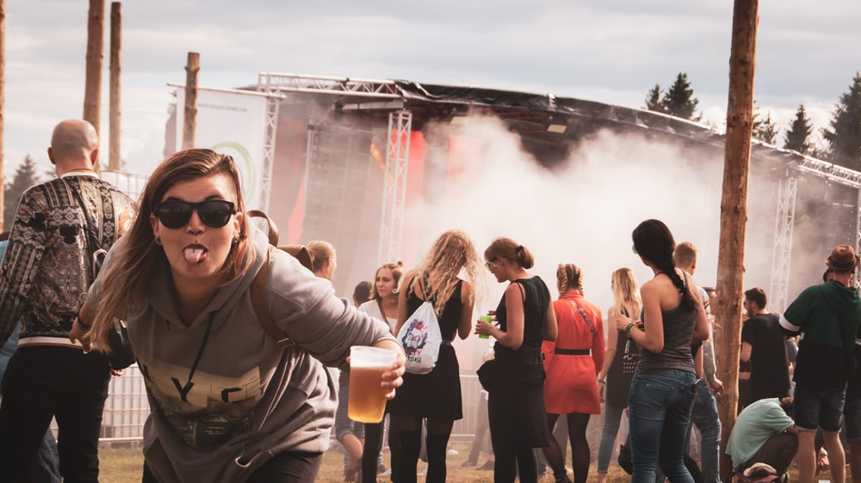
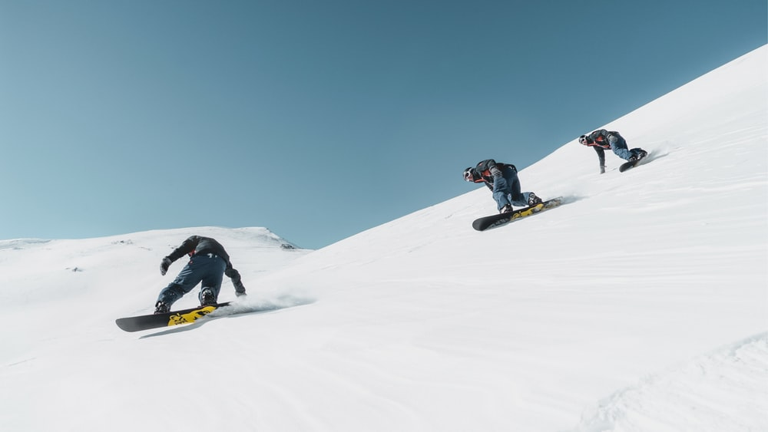
Education Infographic
Blogger
Elope
Escape
New years resolution
Unusual
Adventure
Belongings
Dream
Resilient
Wishlist
Teachers
Education
Skills
Chris Bauman

